Slide 1
Software Architecture for Blockchain Applications: Lecture 6 – Use Cases
Source of most materials:
Xiwei Xu, Ingo Weber, and Mark Staples. Architecture for Blockchain Applications. Springer, 2019

Slide 2
Use Cases

Slide 3
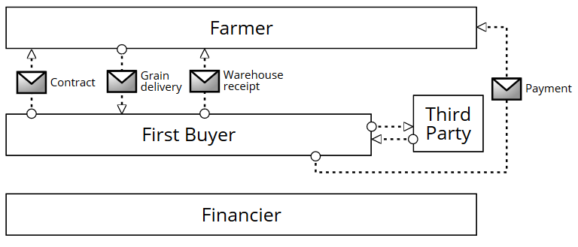
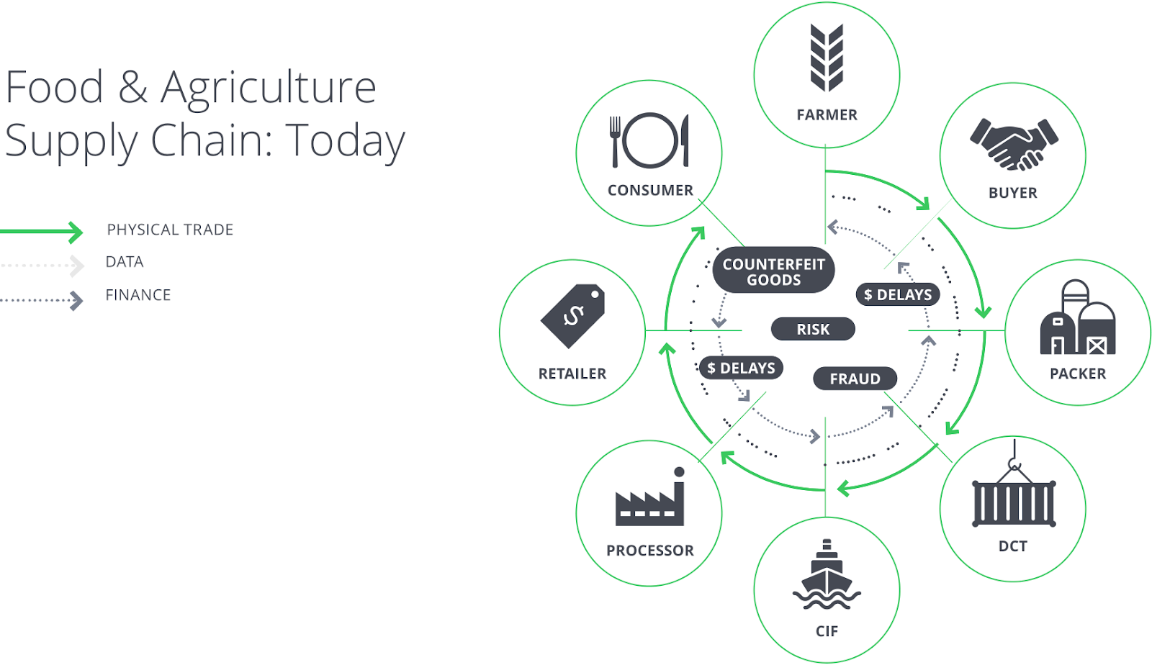
Use Case: Supply Chains
Sample Agricultural Supply Chain Network
Fig. 2 Collaboration between the farmer and the first buyer without involvement by a financier.
Fig. 1 Traditional agri-supply chains, with separate flows for trade, data, and finance. © 2018 AgriDigital. Reprinted with permission.
Source: Luise Pufahl et al.: Enabling Financing in Agricultural Supply Chains through Blockchain. In book: Business Process Management Cases, Vol. 2, Springer, 2021.

Slide 4
Using Blockchain for Supply Chains
Why?
Irrefutable, tamper-proof data store
Prevent or detect counterfeiting
Smart contracts can check integrity and authorization / authentication
Can solve other problems:
Counter-party risks
Lack of trust, e.g., in coopetition
Supply chain transparency
...
How?
Record supply chain events on blockchain, e.g.:
GS1 EPCIS events
Other tag scans
Phytosanitary certificates
Check that event sequences are correct, e.g. through
Process conformance
Business rules adherence
Can be on-chain or off-chain
Regulatory compliance
Notes:
Electronic Product Code Information Services

Slide 5
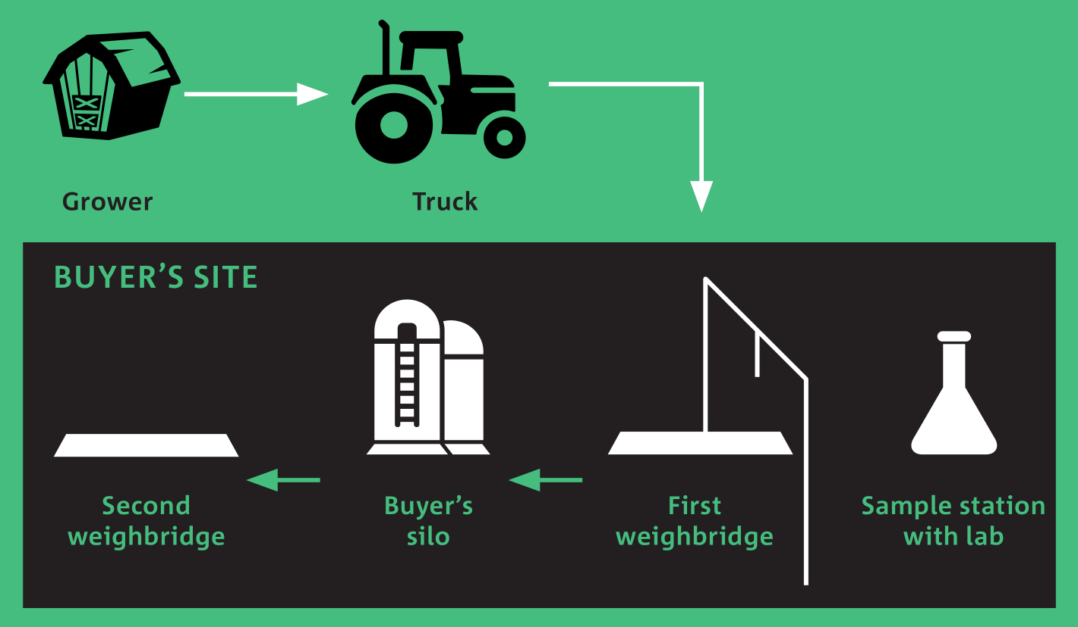
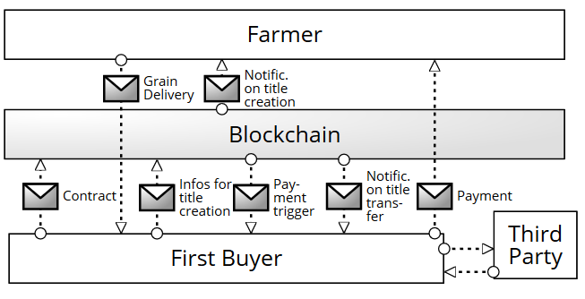
Example: AgriDigital’s first pilot see https://www.data61.csiro.au/blockchain / Chapter 12 in the book
Fig. 3 Collaboration between the farmer and the first buyer with title transfer and immediate payment using the blockchain technology.
Source: Luise Pufahl et al.: Enabling Financing in Agricultural Supply Chains through Blockchain. In book: Business Process Management Cases, Vol. 2, Springer, 2021.

Slide 6
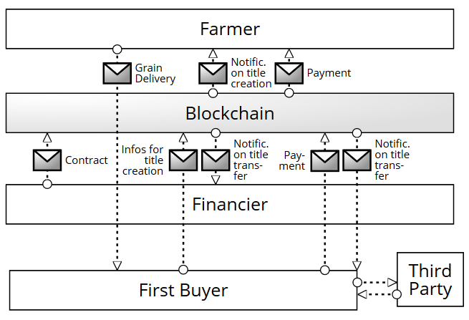
Example: AgriDigital’s third pilot see https://www.data61.csiro.au/blockchain / Chapter 12 in the book
Fig. 5 Collaboration among the farmer, the first buyer, and the commodity financier with the help of blockchain technology (off-chain payments not shown).
Source: Luise Pufahl et al.: Enabling Financing in Agricultural Supply Chains through Blockchain. In book: Business Process Management Cases, Vol. 2, Springer, 2021.

Slide 7
Some Benefits of using Blockchain in Supply Chains
Electronic titles to supply chain goods
Ensure ownership, right to sell, etc are handled correctly
Reduce financial risk – e.g.: if a buyer goes bankrupt before paying for the goods, the seller still owns them
Establish identity and authenticity for:
Requester
Other relevant supply chain participants
Check financial record / trustworthiness
Ensure correctness of specific supply chain documents
E.g., invoice, purchase order, ...

Slide 8
Use Case: International Money Transfers
Many workers in Australia regularly send money back to their families overseas
Up to 10% of GDP in some developing countries (and even 27% in Tonga and 20% in Samoa)
High remittance costs have serious effects in these countries
Remittance costs in Pacific Island countries are among the highest in the world
For example, to send $200 from Australia to Vanuatu costs $33.20 and $28.60 to Samoa
Issues:
Many parties involved, sometimes little transparency
Difficulties of satisfying AML/CTF (Anti-Money Laundering/Counter-Terrorism Financing) regulation, especially where the receiving party may not have a bank account.
High latency, with transaction times up to 5days.

Slide 9
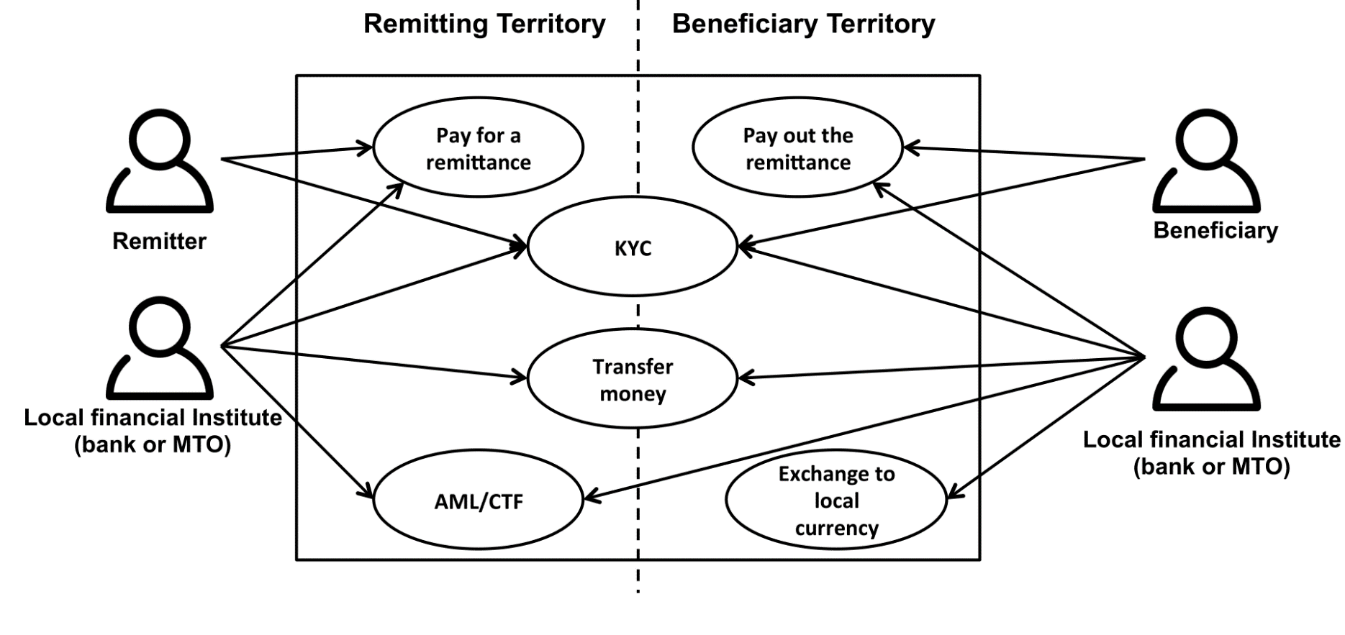
Use Case: International Money Transfers
Stakeholders and Functions
Notes:
Money Transfer Operator

Slide 10
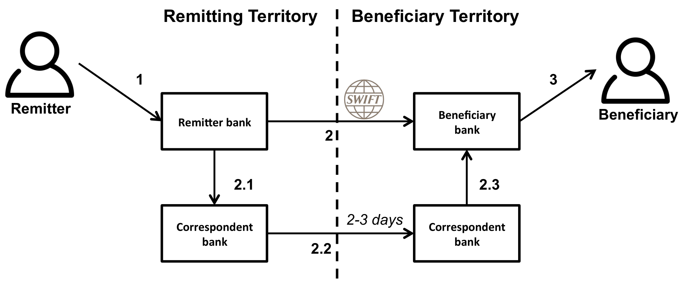
Use Case: International Money Transfers
Remittance through banks
Notes:
Society of Worldwide Interbank Financial Telecommunication or SWIFT is a financial messaging system that runs on a network of tens of thousands of financial institutions from around the world.
The SWIFT system enables these institutions to securely send and receive information on financial transactions in a standardized way.

Slide 11
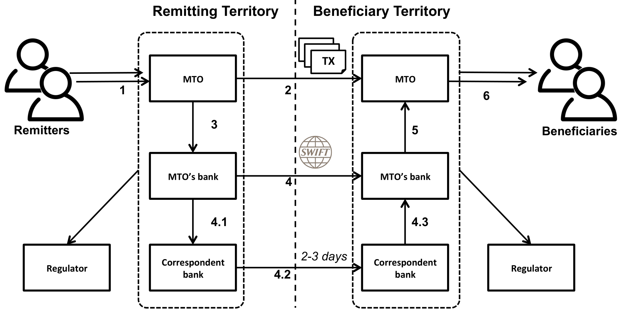
Use Case: International Money Transfers
Remittance through a Money Transfer Operator (MTO)

Slide 12
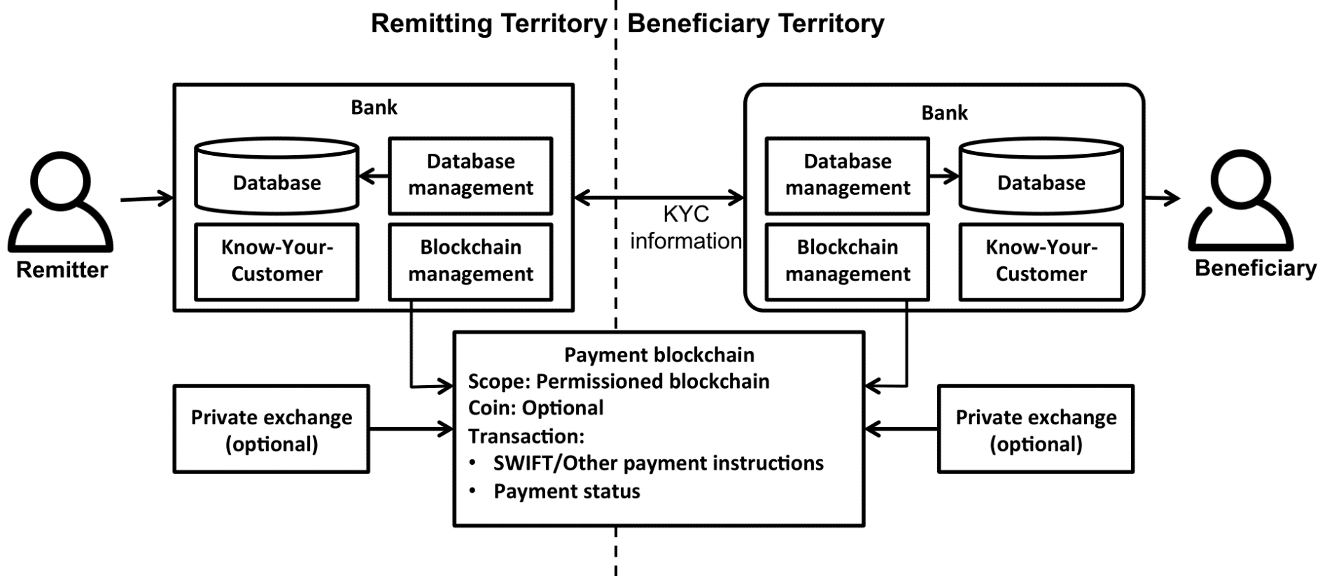
Use Case: International Money Transfers
Remittance through Blockchain
Alternatively, use existing cryptocurrencies like Bitcoin.

Slide 13
Use Case: International Money Transfers
Non-functional Properties
Transaction Latency:
From days (conventional) to hours or minutes (with blockchain)
Cost:
Depends on the fees charged by various parties – but more parties are involved in the conventional designs
Transparency:
Greater in the blockchain setting; foreign exchange rates might still be unfavourable for the customers
Barriers to Entry
Conventional design requires participants to have banking / financial services licenses, and business relationships with correspondent banks
Public blockchains have low barriers to entry, but local regulation still applies to end-points within countries

Slide 14
Software Architecture for Blockchain Applications: Lecture 6 – Use Cases
Source of most materials:
Xiwei Xu, Ingo Weber, and Mark Staples. Architecture for Blockchain Applications. Springer, 2019

